Slide 1
May 8, 2025
QuickBooks
+ Project Management
Adam Eagle
CEO & Founder
Beam
Mary Hunter
VP, Training & Consulting
Out of the Box

Slide 2
Introductions
Mary Hunter
Leveraging her decades as a CPA, Mary provides training to the Out of the Box team and consulting services to clients. Mary’s broad range of expertise includes large and small manufacturers, construction, retail, wholesale distribution, and healthcare, to name a few. Her main areas of focus are ensuring the highest standards of client service through professional education and upskilling of internal teams.

Slide 3
Introductions
Adam Eagle
Started Beam in 2022 with a goal to accelerate the development of housing and infrastructure by empowering builders with better financial tools and services.
Studied computer science at MIT.
Built financial & payments software at Stripe, which now process $1T+ per year.

Slide 4
Introductions
Agenda
QuickBooks Strengths & Gaps
Project Management Needs
Connecting Systems
Q&A
01
02
03
04
05

Slide 5
QuickBooks: Strengths & Gaps
Strength: Accounting
Gap: Job Reporting
Gap: Invoicing & COs
QuickBooks strength lies in putting together financial statements for taxes:
Balance Sheet
P&L
Categorizing expenses and enabling reconciliation of accounts.
Most project-specific accounting is challenging:
Estimated cost vs. actual costs or project budgets
Cost codes or types
Construction-specific workflows are also not built into QuickBooks Online:
Progress invoicing and revenue recognition, including AIA billing
No change order management
Notes:
Importance of managing costs on job
QBO Project-based job reporting is not there:
QBO not great at managing change orders, tracking, project updates
AIA billing: progress invoicing and revenue recognition; better handled in Beam where job details reside
Cost codes: not getting actual cost vs. estimated cost

Slide 6
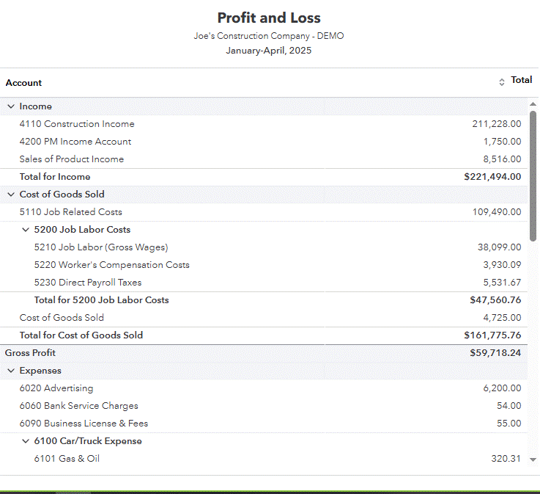
QuickBooks: Strengths & Gaps
Strength: Accounting
Financial statements
Bank and credit card reconciliations
Payroll
General and Administrative expenses
Loans and other liabilities
Tax compliance

Slide 7
Importance of Job Costing
It’s your job budget!
Imperative for Cash Flow forecasting and timely requests for advances
Allows you to measure Prediction vs. Actual
Helps with the bid process on future jobs
Identifies inefficiencies

Slide 8
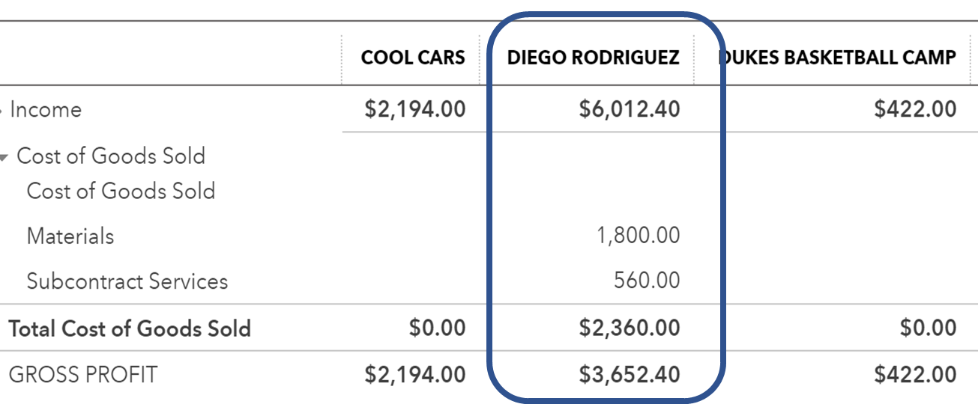
QuickBooks: Strengths & Gaps
Gap: Job Cost Reporting in QBO
Profit & Loss by Job report only shows financial statement categories, not detailed job categories
Does not compare actual costs versus estimated costs
No other job cost reports available

Slide 9
QuickBooks: Strengths & Gaps
Gap: Invoicing & COs
Revenue recognition
Percent completion revenue recognition
AIA billing not available in QuickBooks
CO tracking difficult in QuickBooks
Project managers and other users do not need access to QuickBooks/financial data

Slide 10
Project Management Needs
Estimating & Takeoff
Project Budgeting
Project Scheduling
QuickBooks estimating isn’t robust enough. Missing:
Estimate templates
Cost libraries
Bid management
Proposal templates
Project finances aren’t particularly strong in QuickBooks. Missing:
Estimate vs. actuals
WIPs
Change orders
Contingency
Progress invoicing
QuickBooks doesn’t offer scheduling or task management, but these inexpensive tools do:
Smartsheet
Microsoft Projects
Asana
Buildertrend

Slide 11
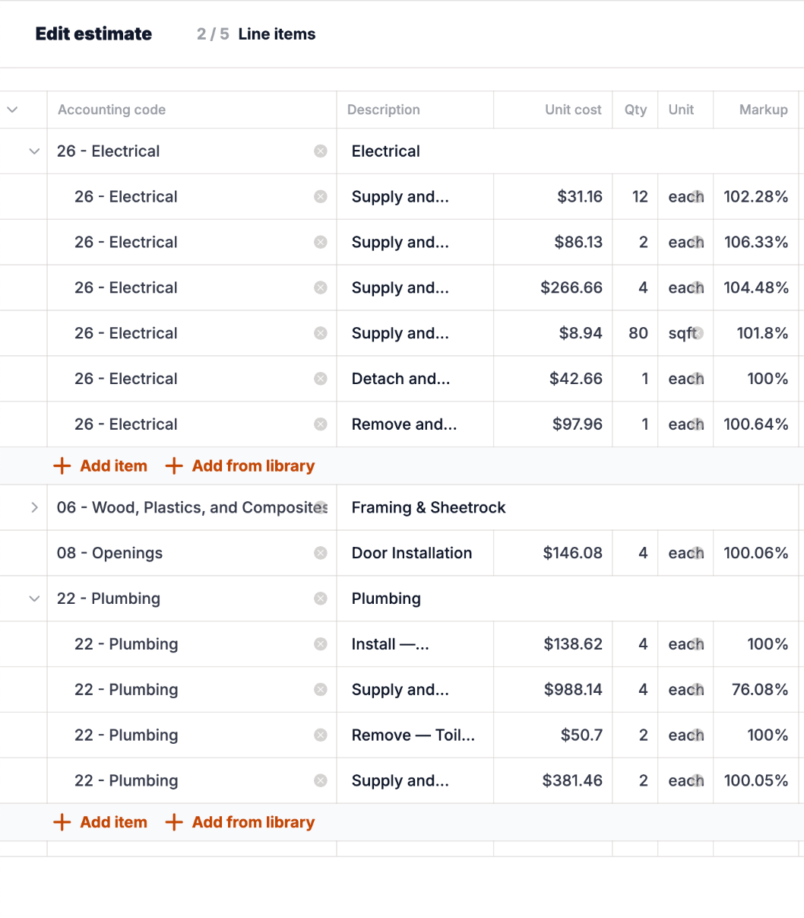
Project Management Needs
Estimating & Takeoff
An accurate estimate is the foundation of every profitable job.
Look for software that supports:
Templates
Cost libraries
Markup/margin
Cost coding
Grouping or sectioning

Slide 12
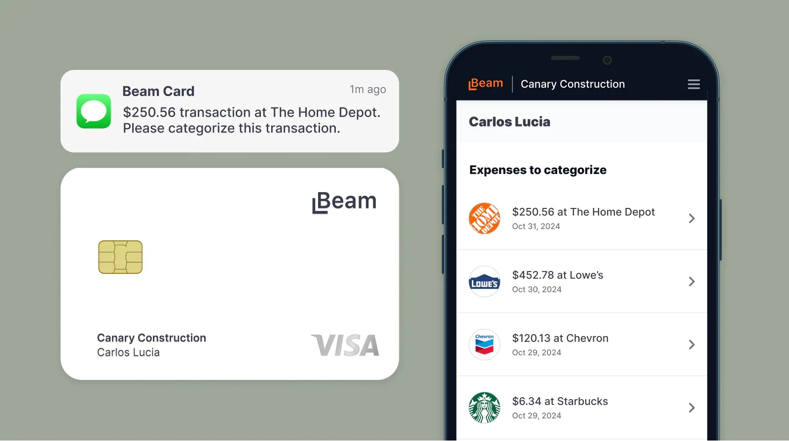
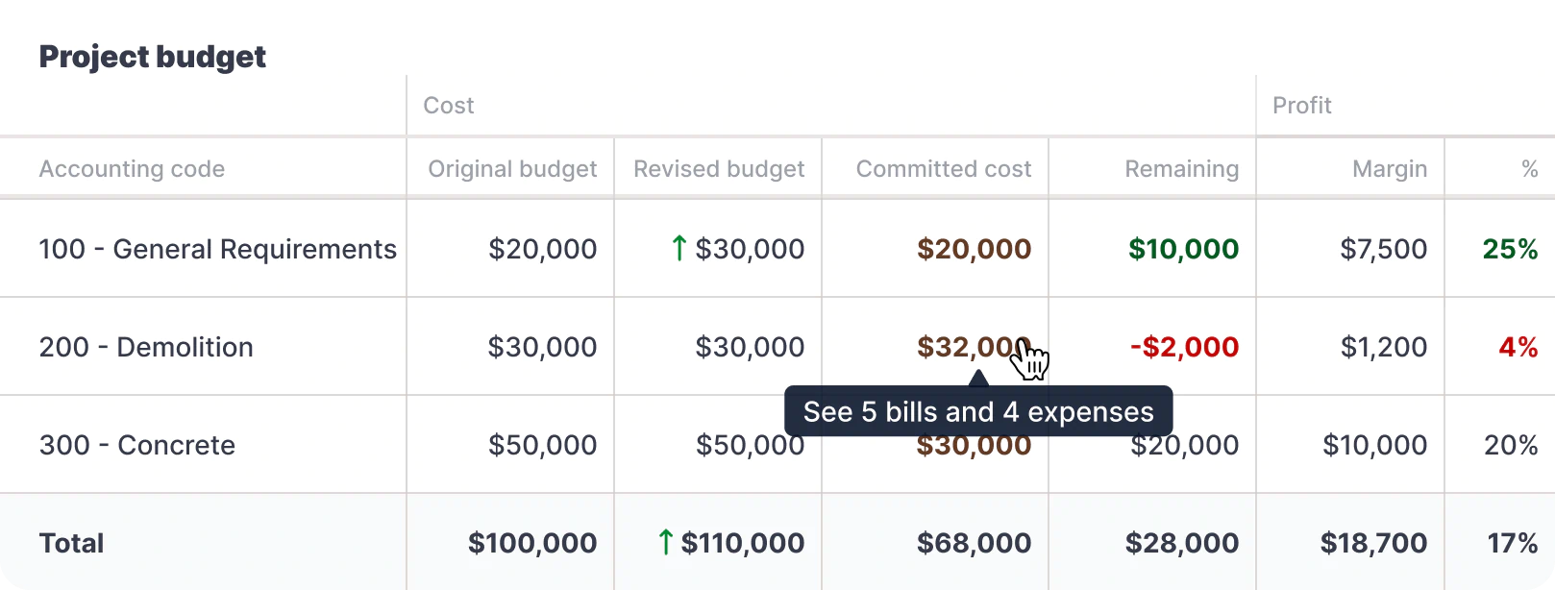
Project Management Needs
Project Budgeting
Once an estimate is approved, profitability is dictated by your costs and how you manage your change orders.
Look for software that supports:
Tracking commitments (POs)
Change order management
Estimate vs. Actuals / WIPs
Expense management
Bill reconciliation by project/code
Progress invoicing

Slide 13
Project Management Needs
Project Scheduling
Projects also live and die by their schedules.
QuickBooks doesn’t offer scheduling, GANTT charts, or task management.
We recommend:
Low-cost software like Smartsheet, Microsoft Project, or Monday.com
Or more expensive but construction specific tools like Buildertrend or Fieldwire

Slide 14
Connecting Tools
Real-time or batch?
One-way or two-way?
Proper payment reconciliation?
Using products & services + accounts?

Slide 15
Live Demo
Notes:
Pulsari, schedule a bill, sub portal

Slide 16
Q&A
Notes:
Pulsari, schedule a bill, sub portal

