Slide 1
June 5, 2025
Embedded Renovation Financing
Your Competitive Advantage
Adam Eagle
CEO & Founder
Beam
Madelyn Schmidt
Partnership Manager
RenoFi

Slide 2
Introductions
Madelyn Schmidt
Partnership Manager at RenoFi
With over 10 years of experience in the mortgage and financial industry, Madelyn is able to provide insight into new and innovative financing options to help service providers and contractors secure more projects.

Slide 3
Introductions
Adam Eagle
Started Beam in 2022 with a goal to accelerate the development of housing and infrastructure by empowering builders with better financial tools and services.
Studied computer science at MIT.
Built financial & payments software at Stripe, which now process $1T+ per year.

Slide 4
Introductions
Agenda
Why Financing
Presenting Financing
Real World Examples
Demo + Q&A
01
02
03
04
05

Slide 5
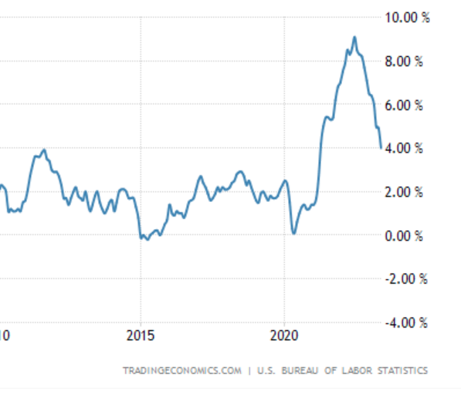
Why Financing?
Inflation
Mortgage Rates
Aging Housing Stock
24M
24.1M
23.4M
22.9M
22.4M
21.9M
‘19
‘20
‘21
‘22
‘23
‘24
‘25
‘26
‘27

Slide 6
Financing offers strengthen proposals
Contractors can guide homeowners through the renovation process, including financing
Homeowners might hold off until they can secure financing
Homeowners may want to increase scope once they’ve secured financing

Slide 7
How do Contractors benefit from offering financing?
100% wishlist ≠ 100% of budget
Capitalize on upselling opportunities
Increase project sizes - Help homeowners consider the renovation as a monthly expense rather than a lump sum payment. Turn a savings exercise into a budgeting exercise
Increase conversion rates on projects where financing is a hurdle, or where customer wishlist was more expensive than they initially thought

Slide 8
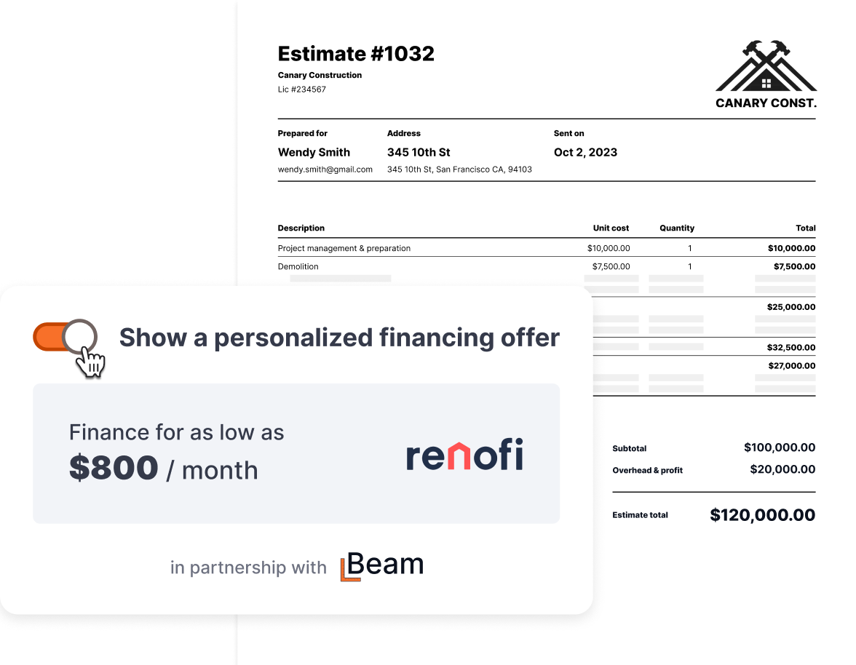
Presenting Financing
Embedding financing in the proposal
Rather than separating financing from the proposal, show a manageable monthly price to homeowners as part of the estimate
Financing shouldn’t be taboo, but homeowners might not always feel comfortable asking about it
Link directly to the pre-qualification process

Slide 9
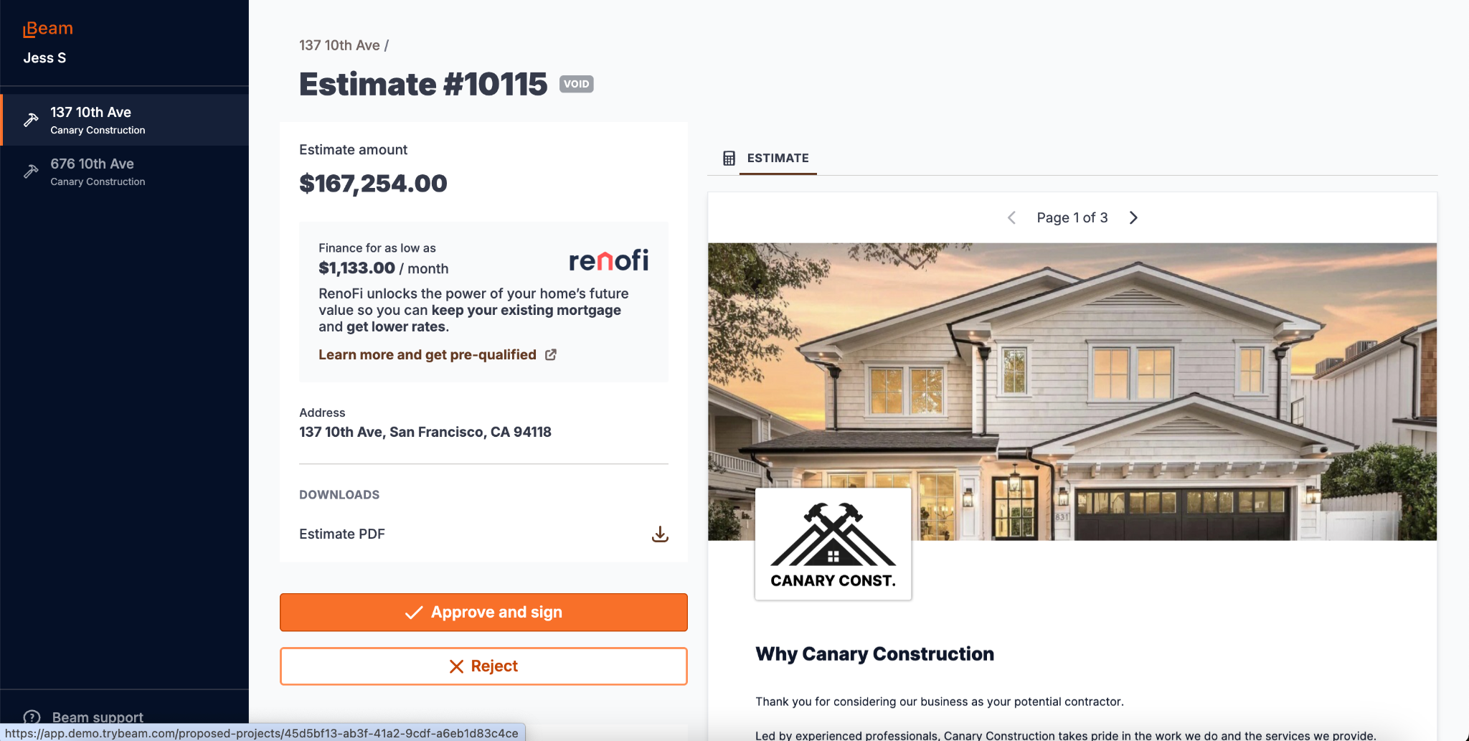

Slide 10
Real World Examples
Contractor WINS with RenoFi
Greg Harth
President, Harth Builders
Nick Drasby
Owner, Great Additions Construction
“What I appreciate most about RenoFi is the simplicity of their solution. For my clients RenoFi has created an easy online application for me, the contractor, there is no burdensome inspection and draw schedule.”
“These days, people don’t want to touch their primary mortgage with a rate from years ago, so RenoFi being able to lend in 2nd position has been a tremendous help! Many projects would not have otherwise been doable if not for our clients working with them!”

Slide 11
Real World Examples
Renovation Financing = Better Projects
High-end ADU builder in San Jose: projects often exceed $500,000. Renovation financing allows clients to build stronger investments.
Albany, CA GC: win rates are significantly higher when clients navigate financing through the general contractor. Building trust.

Slide 12
Live Demo

Slide 13
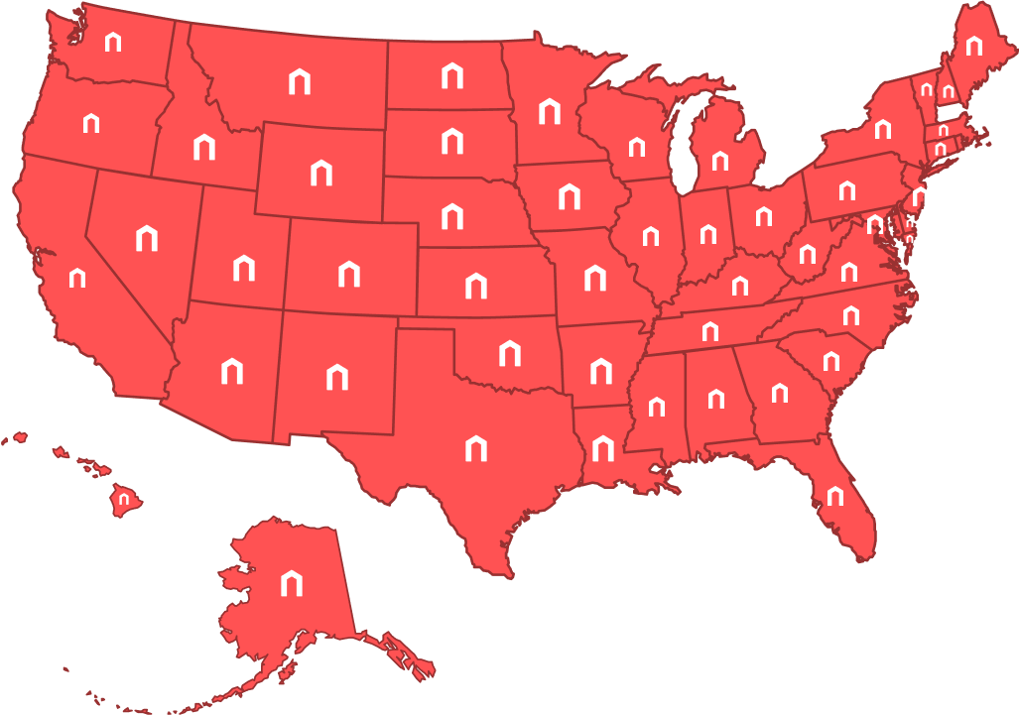
Introducing Loans
Simplified with
Borrow up to 90% of the after renovation value
100% funds available at closing, no draws/inspections
Loans up to $500,000
No prepayment penalties
Flexible payment options
Notes:
Homeowners need financing more than ever!
In addition to a declining housing market, inflation has led to homeowners being cash poor.
Leverage RenoFi as an added tool.
With so many different loans out there (not designed for renovations), help your homeowners find a loan designed for REMODELERS!

Slide 14
Q&A

